Slide 1
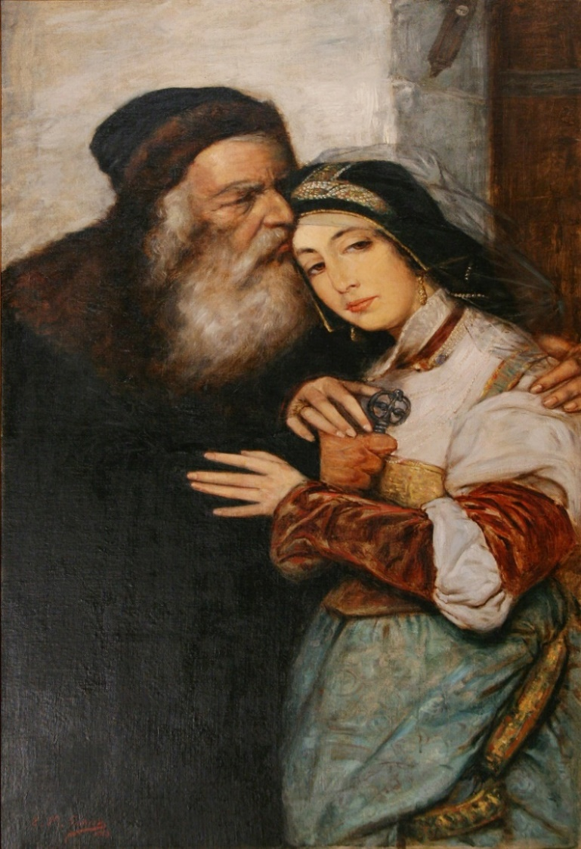
What Jairus’ Daughter Saw in Her Father
睚魯的女兒在她的父親身上看到甚麼
Mark 馬可福音 5:21-24, 35-42

Slide 2
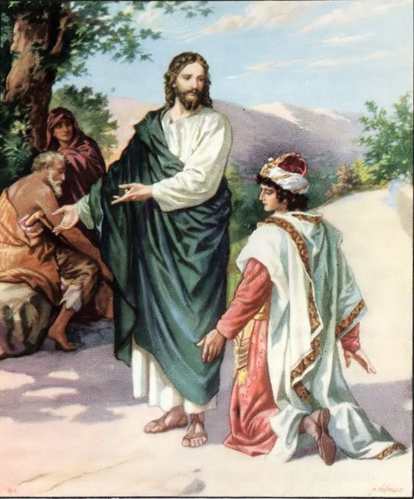
1. She saw her father was not ashamed to seek out Jesus.
她看到的是她的父親不恥於尋求耶穌

Slide 3
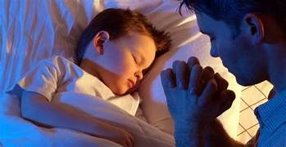
What Does a Good Father Do?
一個好父親該做甚麼?
1. Dedicates his children to God.
致力於將孩子奉獻給神

Slide 4
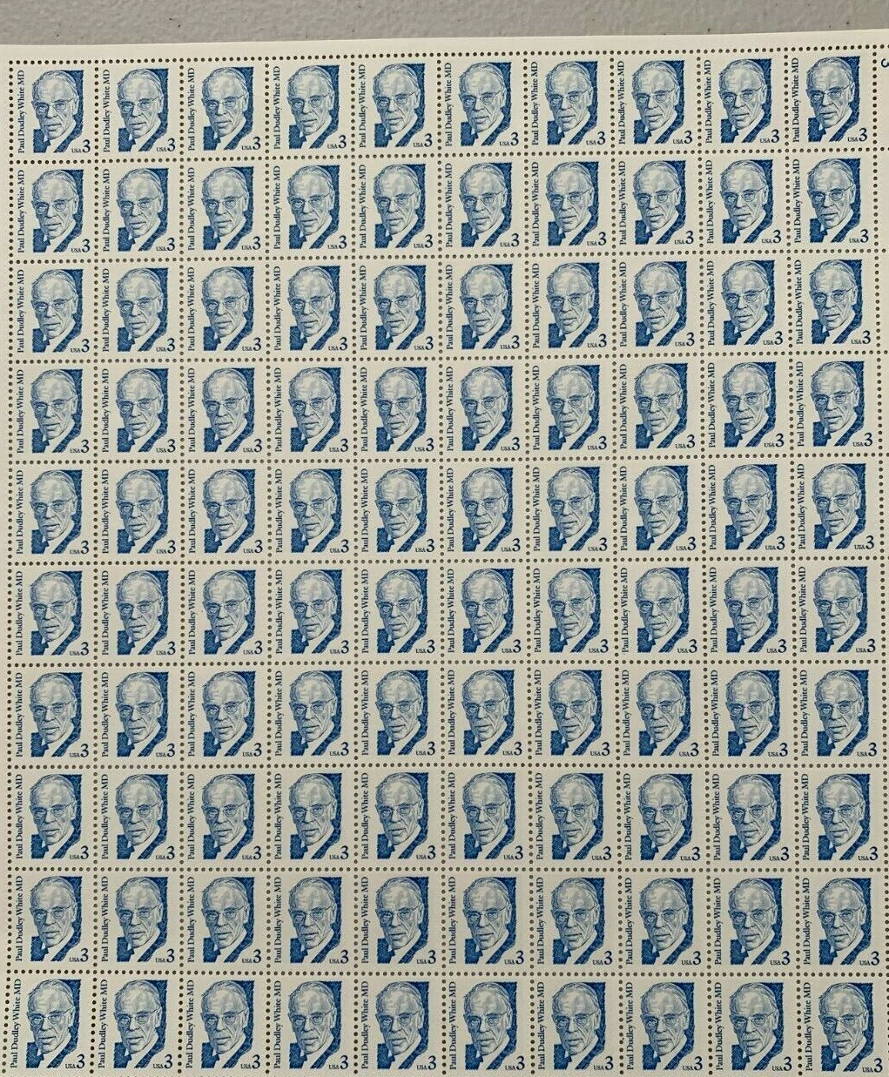
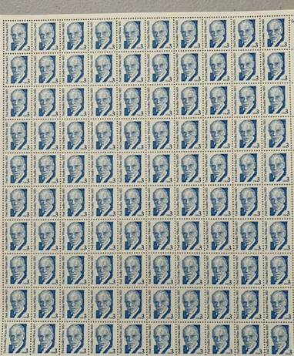
What Does a Good Father Do?
一個好父親該做甚麼?
2. Teaches his children to honor and respect the Lord. 教導孩子榮耀, 敬畏神並做對的事

Slide 5
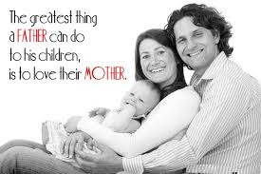
What Does a Good Father Do?
一個好父親該做甚麼?
3. Loves his wife.
愛他的妻子

Slide 6

你在教導你的兒子如何對待異性, 也教導你的女兒如何選擇異性

Slide 7
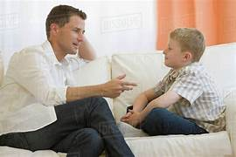

“You know how we are alike?
你知道我們的相似之處嗎?
We both love the same woman! 我們都愛同一個女人

Slide 8
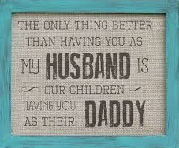
你身為我的丈夫更好的事情是你是孩子們的爸爸

Slide 9
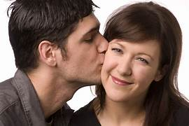
Have fewer accidents & live longer

Slide 10
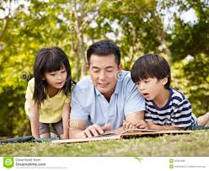
What Does a Good Father Do?
一個好父親該做甚麼?
4. Spends time with his children. 陪伴孩子

Slide 11
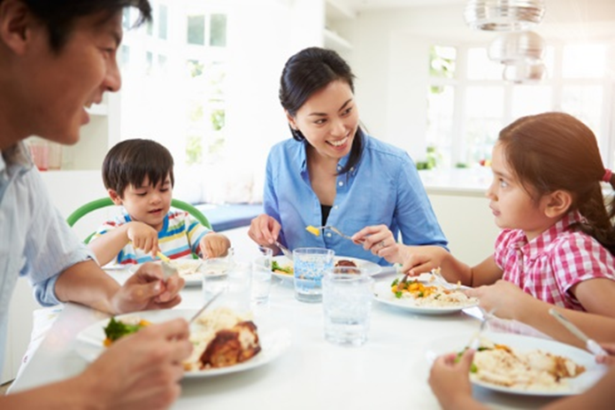
“Will you spend time with me?”
你會陪我嗎?

Slide 12
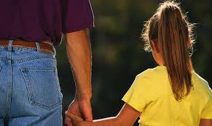

What Does a Good Dad Do?
個好父親會做的事
Takes a walk with me.
與我一同散步
Tells me a story.
講故事給我聽
Helps me pick flowers for Mom.
幫我摘美丽的鮮花送給媽媽。
Helps me feed my dog.
幫我餵我的狗
Reads me my favorite book.
讀我最喜歡的書給我聽

Slide 13
“I noticed that not one of those things involved me buying anything for her but they all involved me spending time with her.”
我注意到這些事情中沒有一件涉及我為他買的任何東西, 但這些事情中都是我與她共度的時光

Slide 14
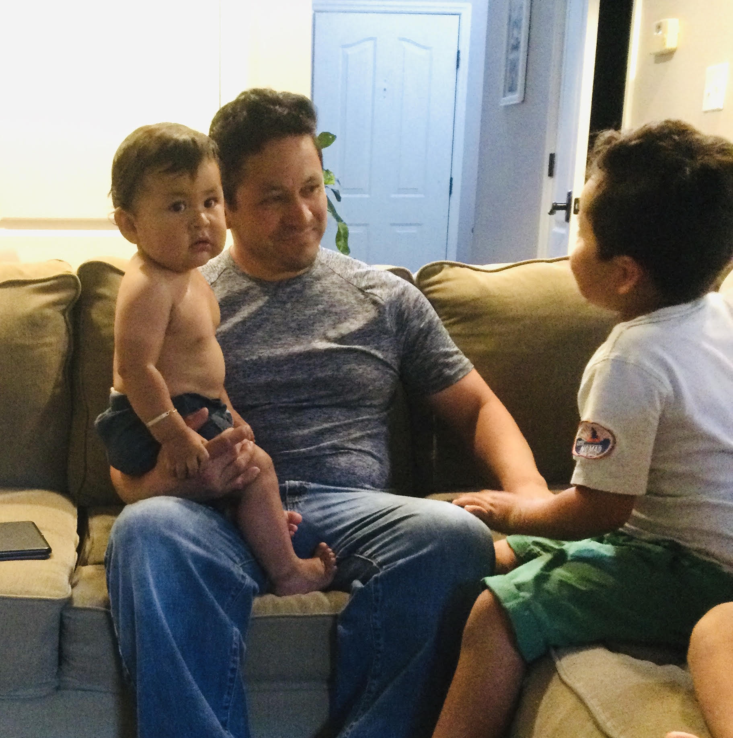
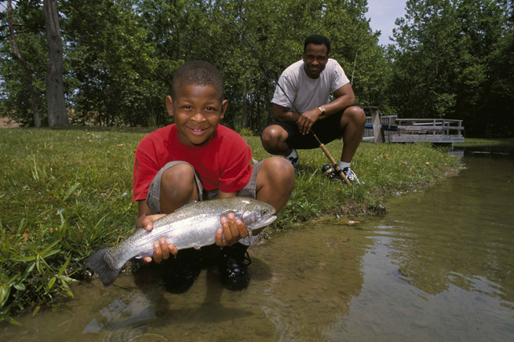
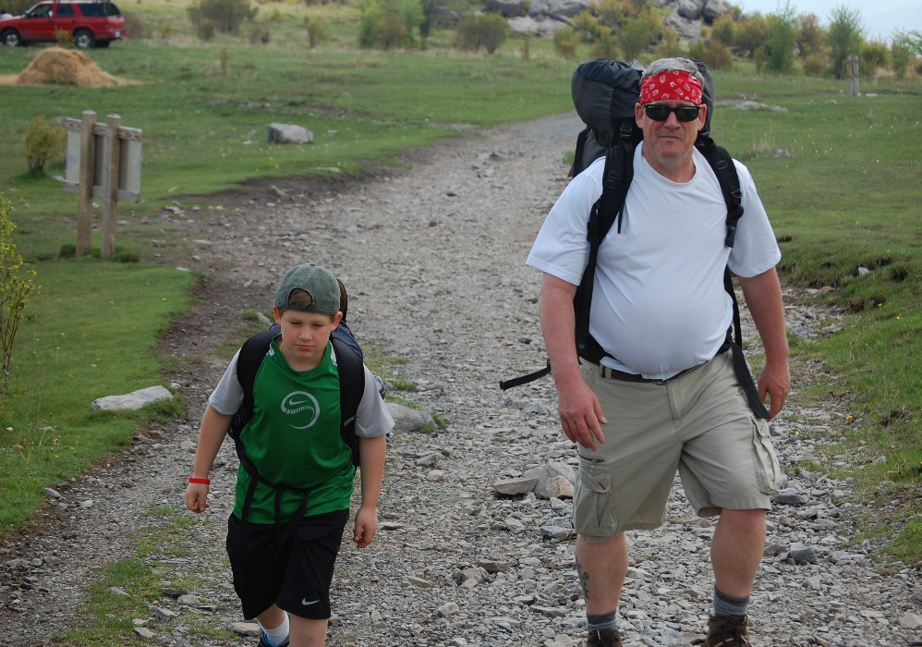
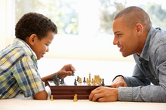

Slide 15
My child arrived just the other day
He came to the world in the usual way
But there were planes to catch and bills to pay
He learned to walk while I was away
And he was talkin' 'fore I knew it, and as he grew
He'd say "I'm gonna be like you, Dad
You know I'm gonna be like you"
我的孩子出生了 每個人
都會經歷這個過程
我每天仍然忙著工作，出差和賺錢
不知不覺，他學會走路了
他什麼時候會講話了我都不知道
兒子說：『爸爸，我長大要像你一樣』
『我要像你一樣…爸爸』

Slide 16
My son turned ten just the other day
He said, "Thanks for the ball, Dad, come on let's play
Can you teach me to throw", I said "Not today
I got a lot to do", he said, "That's okay"
And he walked away but his smile never dimmed
And said, "I'm gonna be like him, yeah
You know I'm gonna be like him"
我的兒子十歲了 我買了一顆球給他，他好高興，找我一起玩球
『爸爸，你可以教我怎麼投球嗎？』，我說：『不，我今天沒空』
『我很忙』；他說：『沒關係』
兒子微笑，他走開了
他說：『爸爸，我長大會像你一樣』
『我會跟你一樣…』

Slide 17
Well, he came from college just the other day
So much like a man I just had to say
"Son, I'm proud of you, can you sit for a while"
He shook his head and then said with a smile
"What I'd really like, Dad, is to borrow the car keys
See you later, can I have them please"
我的兒子上大學了
我不知道該和兒子聊些什麼，我只好對他說…
兒子，我真驕傲，你能留在這裡，陪我坐一下嗎？
兒子搖了搖頭，他微笑著說…
『爸爸，我其實，只是要來向你借車鑰匙』
『等會再聊好嗎？車子借我』

Slide 18
I've long since retired, my son's moved away
I called him up just the other day
I said, "I'd like to see you if you don't mind"
He said, "I'd love to, Dad, if I can find the time
You see my new job's a hassle and the kid's got the flu
But it's sure nice talking to you, Dad
It's been sure nice talking to you"
And as I hung up the phone it occurred to me
He'd grown up just like me
My boy was just like me
我退休了很久，兒子也離開家
我打電話給他，想和他聊聊
我說：『兒子，我想見見你，好嗎？』
他回答：『爸爸，我也想見你，但是我沒有空』
『因為，我的新工作很忙，我的小孩又生病了…』
『不過，爸爸，跟你聊天很愉快…』
『和你聊得很愉快……』
當我掛下電話的時候，我猛然想到…』
以前，我也是這麼對待我的孩子的…
現在，他也這麼對我了…

Slide 19
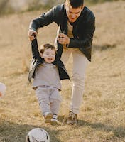
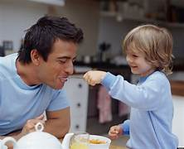
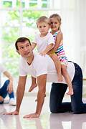
Question: Do you want your children to grow up just like you? 問:你希望你的孩子長大以後像你一樣嗎?
A good father spends time with his children.
一個好父親陪伴他的孩子

Slide 20
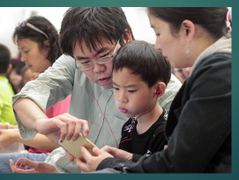
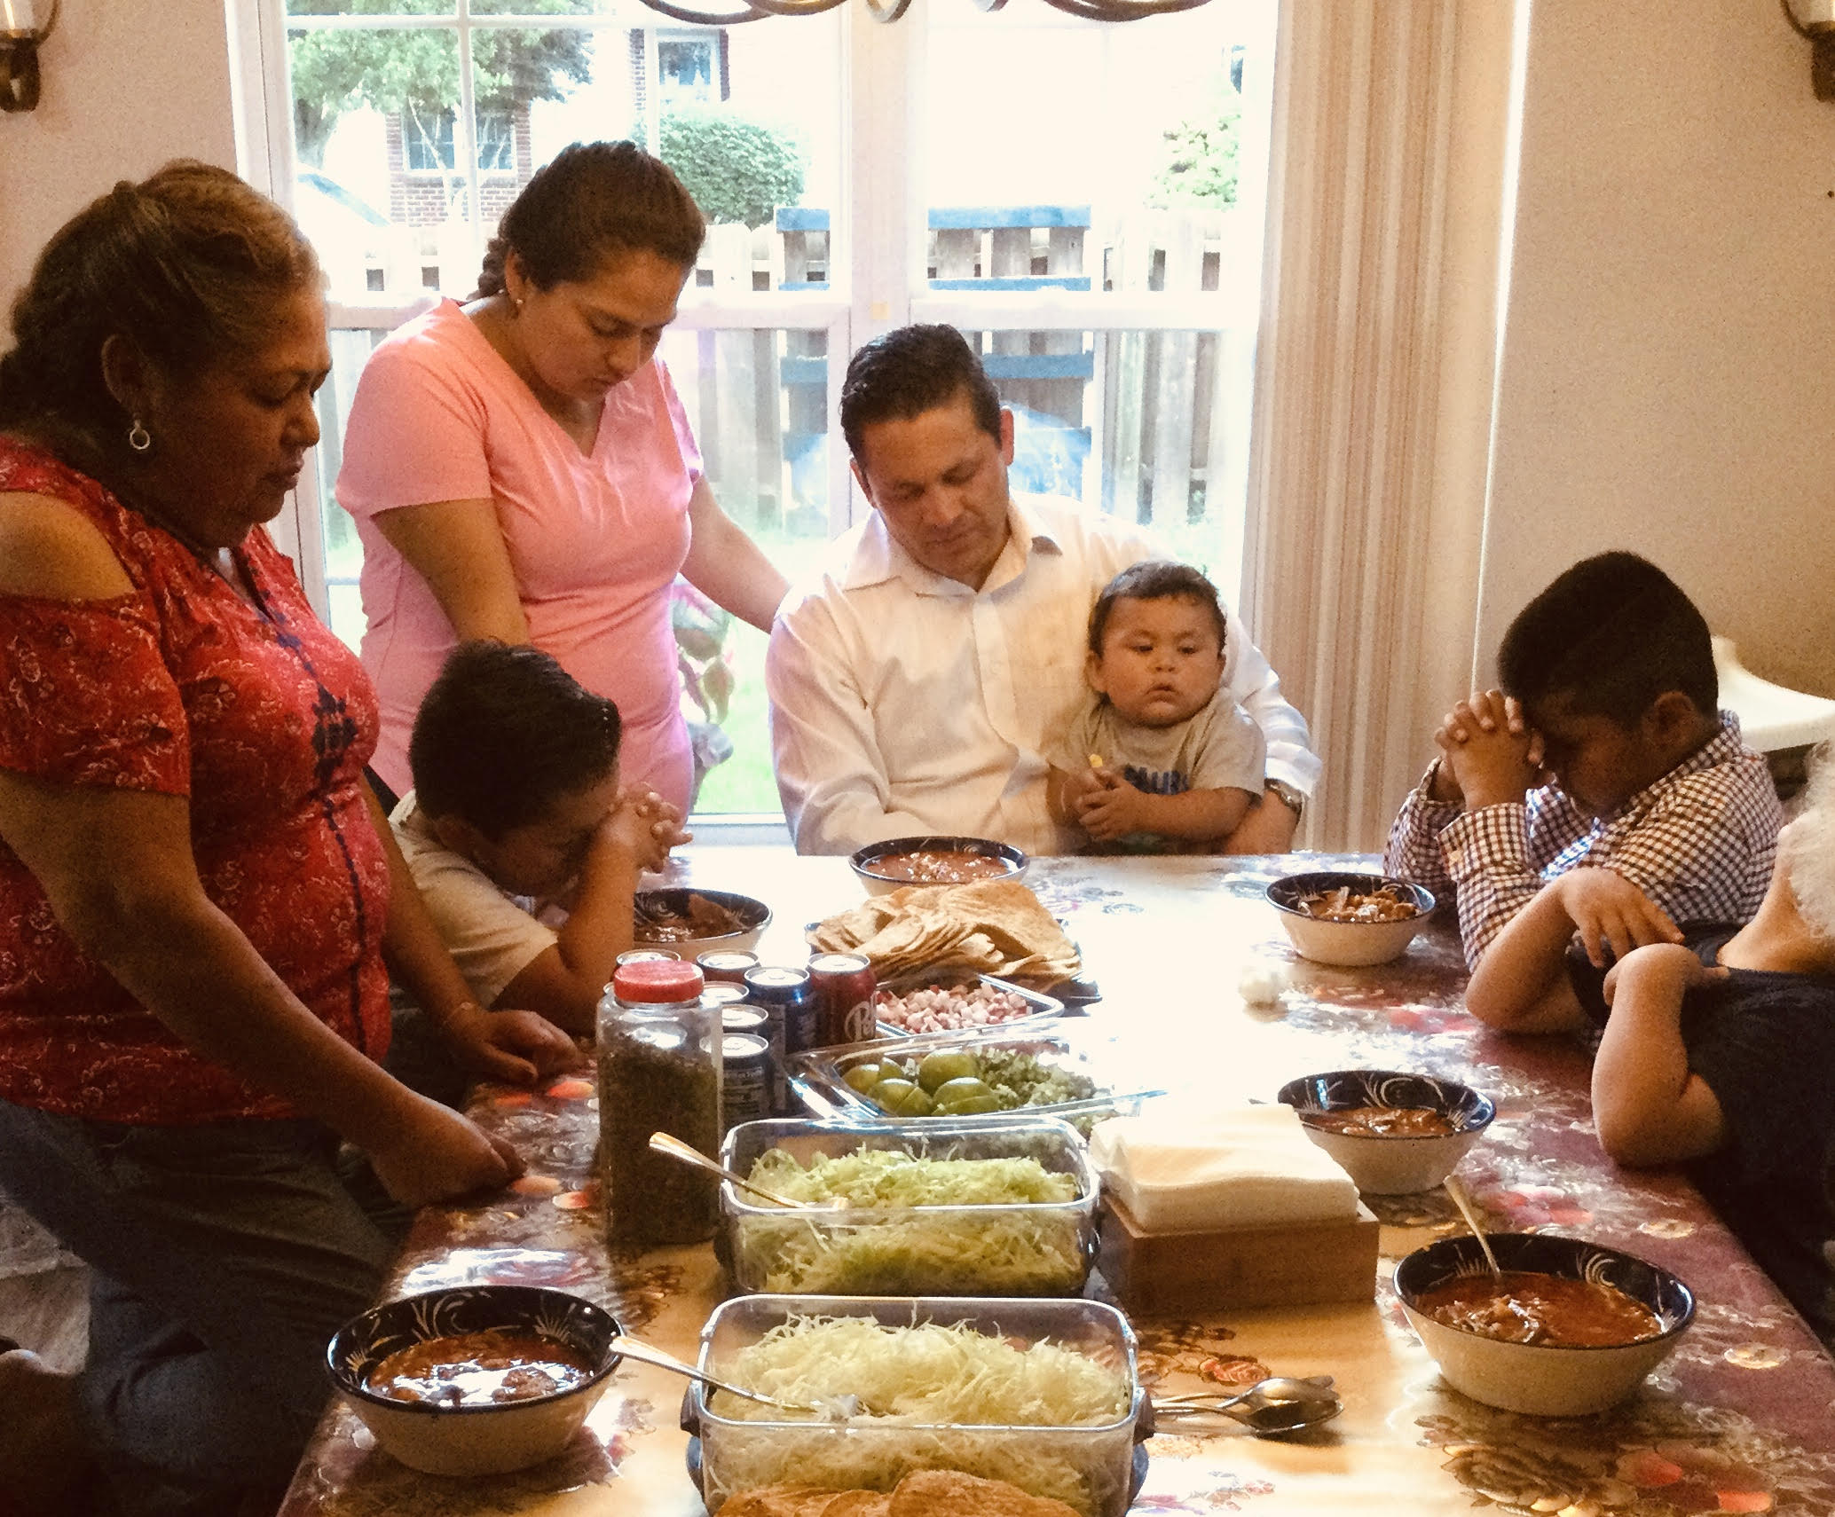
What Does a Good Father Do? 一個好父親該做甚麼?
5. Instructs his children in the importance of prayer and
指導孩子禱告的重要性與
the reading of God’s Word.
研讀上帝的話語

Slide 21
How to Pray 如何禱告
PF—Pray First 做任何事前禱告
PA—Pray After 做任何事後禱告
PA—Pray Always 隨時禱告

Slide 22
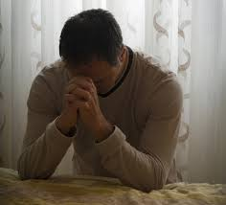
My Dad praying for us
我的父親為我們禱告

Slide 23
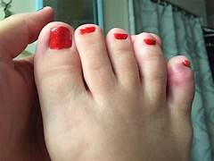
What type of feet do I have?
你的腳是甚麼樣的腳?

Slide 24
What type of feet does God say you have? 上帝說你有甚麼樣的腳
“…how beautiful are the feet of those who bring good news.” Romans 10:15
“…報 福 音 、 傳 喜 信 的 人 ， 他 們 的 腳 蹤 何 等 佳 美” 羅馬書 10:15

Slide 25
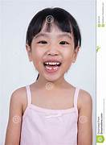
A good father instructs his children of the importance of prayer and the reading of the Word of God.
指導孩子禱告的重要性與研讀上帝的話語
“I have beautiful feet!”
“我有一双美丽的脚！”

Slide 26
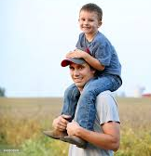
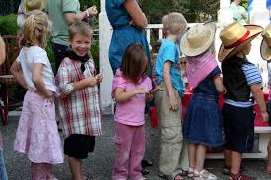
What Does a Good Father Do?
一個好父親會做的事
6. Teach by our life and our actions, not just our words. 不光是言語上教導你的孩子更要在日常生活與行動中行出來

Slide 27
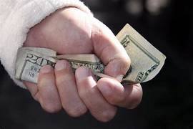
“Sir, I think you dropped this.”
先生, 你掉的這個

Slide 28
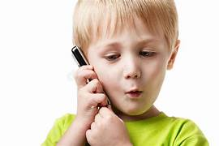
“My dad said he is not at home.”

Slide 29
1. She saw her father was not ashamed to seek out Jesus.
她看到的是她的父親不恥於尋求耶穌

Slide 30
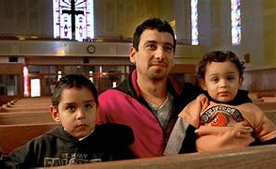
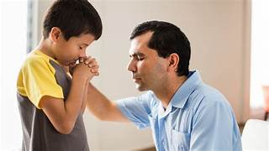
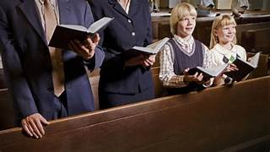

Slide 31
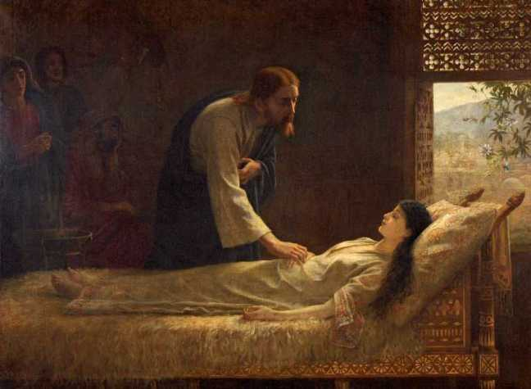
2. She saw her father was not ashamed to bring Jesus into their home.
她看到的是她的父親不恥於讓耶穌進家門

Slide 32
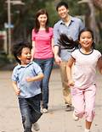
“”I was glad when they said to me, ‘Let us go into the house of the Lord.’” Psalm 122:1
人 對 我 說 ： 我 們 往 耶 和 華 的 殿 去 ， 我 就 歡 喜 。 詩篇 122:1

Slide 33
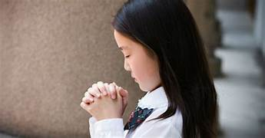
“Coming to church is like walking into the heart of God.”
來到教會就像走進神的心”

Slide 34
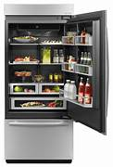
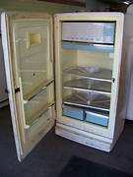
“Let’s give Jesus our junk.”
給耶穌我們不用的的東西吧

Slide 35
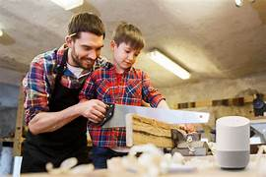
“Except the LORD build the house, they labor in vain that build it…” Psalm 127:1
“ 若 不 是 耶 和 華 建 造 房 屋 ， 建 造 的 人 就 枉 然 勞 力…”詩篇 127:1

Slide 36
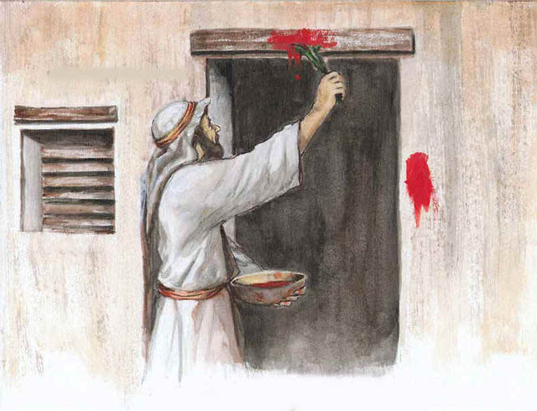
Passover-Father protecting his children
逾越節 - 父親保護他的孩子

Slide 37
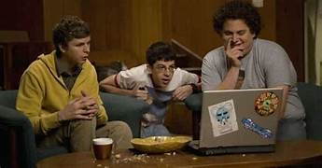
“The thief comes to steal, and to kill, and to destroy:” John 10:10
盜 賊 來 ， 無 非 要 偷 竊 ， 殺 害 ， 毀 壞 ；約翰福音10:10

Slide 38
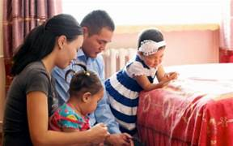
—“AS FOR ME and MY HOUSE, WE WILL SERVE THE LORD.” Joshua 24:15
至 於 我 和 我 家 ， 我 們 必 定 事 奉 耶 和 華 約書亞記 24:15

Slide 39
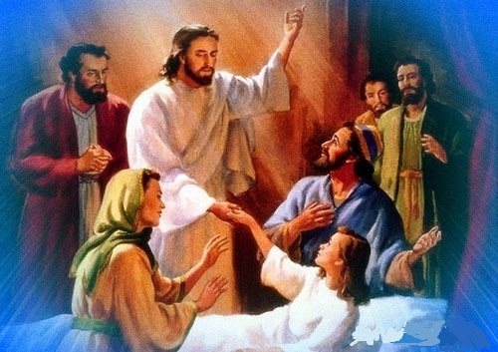
“And He took the girl by the hand and said to her, ‘Little girl, I say to you, get up!’ Immediately the girl stood up and walked around. At this they were completely astonished.” Mark 5:41-42
祂拉着孩子的手说：大利大古米“，！”意思是：小女孩，我吩咐你起来！”小女孩应声而起，并且可以走动，那时她十二岁。在场的人都惊奇不已。馬可福音 5:41-42

Slide 40
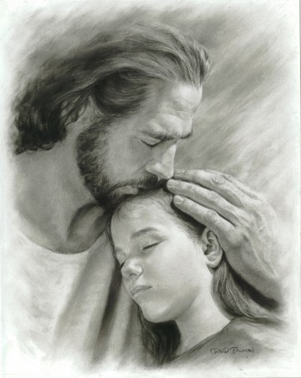
3. She saw her father was not ashamed to express his love toward her.
她看到的是她的父親不恥於向她顯現父愛

Slide 41
Remember 謹記
Fathers, let your children see you seek the Lord.
父親們, 讓你的孩子看見你尋求神
Fathers, let your children know Jesus is welcome in your home.
父親們, 讓你的孩子知道耶穌在你家中是受歡迎的
Fathers, don’t be ashamed to show your love to your wife and children.
父親們, 不要羞於向你的妻子和孩子表達你的愛

Slide 42
Prayer for Fathers
給所有父親的禱告

Slide 43
